Slide 1
Processor Architecture

Slide 2
Coverage
Our Approach
  Work through designs for particular instruction set
    Y86---a simplified version of the Intel IA32 (a.k.a. x86).
    If you know one, you more-or-less know them all
  Work at “microarchitectural” level
    Assemble basic hardware blocks into overall processor structure
      Memories, functional units, etc.
    Surround by control logic to make sure each instruction flows through properly
  Use simple hardware description language to describe control logic
    Can extend and modify
    Test via simulation
    Route to design using Verilog Hardware Description Language
      See Web aside ARCH:VLOG

Slide 3
Goal
Understand basic computer organization
  Instruction set architecture
Deeply explore the CPU working mechanism
  How the instruction is executed
Help you programming
  Fully understand how computer is organized and works will help you write more stable and efficient code

Slide 4
Today’s Topics
Y86 instruction set architecture
Suggested Reading: 3.4~3.7, 4.1

Slide 5
Instruction Set Architecture #1
What is it ?
  Assemble Language Abstraction
  Machine Language Abstraction
What does it provide?
  An abstraction of the real computer, hide the details of implementation
    The syntax of computer instructions
    The semantics of instructions
    The execution model
    Programmer-visible computer status
Instruction Set Architecture (ISA)
Notes:
Syntax:语法
Semantics：语意

Slide 6
Instruction Set Architecture #2
Assembly Language View
  Processor state
    Registers, memory, …
  Instructions
    addl, movl, leal, …
    How instructions are encoded as bytes
Layer of Abstraction
  Above: how to program machine
    Processor executes instructions in a sequence
  Below: what needs to be built
    Use tricks to make it run fast
    E.g., execute multiple instructions simultaneously
Application
Program
Compiler
OS
ISA
CPU Design
(architecture)
Circuit
Design (circuit)
Chip
Layout(device)

Slide 7
Instruction Set Architecture #3
ISA define the processor family
  Two main kind: RISC and CISC
    RISC: SPARC, MIPS, PowerPC, ARM
    CISC: X86 (or called IA32)
Under same ISA, there are many different processors
  From different manufacturers
    X86 from Intel, AMD and VIA
  Different models (microarchitectures)
    8086, 80386, Pentium, Pentium 4
Notes:
This is the modern division. There are other kinds besides superscalar, VLIW and EPIC, e.g. vector machine, stack machine (example is X87)
We will cover some of these topics in the last lesson of cpu design.

Slide 8
Y86 Processor State
  Program Registers
    Same 8 as with IA32. Each 32 bits
  Condition Codes
    Single-bit flags set by arithmetic or logical instructions
      OF: Overflow ZF: Zero SF: Negative
  Program Counter
    Indicates address of instruction
  Memory
    Byte-addressable storage array
    Words stored in little-endian byte order
Program registers
%eax
%esi
%ecx
%edi
%edx
%esp
%ebx
%ebp
Condition codes
OF
ZF
SF
PC
Memory
Notes:
little-endian：小端 高高低低（低位字节放在低地址，高位字节放在高地址）
big-endian：大端 高低高低（低位字节放在高地址，高位字节放在低地址）
一个32位的整数0x12345678
地址偏移 大端模式 小端模式
0x00 12 78
0x01 34 56
0x02 56 34
0x03 78 12

Slide 9
Y86 Instruction Set #1
Byte
0
1
2
3
4
5
halt
0
0
nop
1
0
cmovXX rA, rB
2
fn
rA
rB
irmovl V, rB
3
0
F
rB
V
rmmovl rA, D(rB)
4
0
rA
rB
D
mrmovl D(rB), rA
5
0
rA
rB
D
OPl rA, rB
6
fn
rA
rB
jXX Dest
7
fn
Dest
call Dest
8
0
Dest
ret
9
0
pushl rA
A
0
rA
F
popl rA
B
0
rA
F
Notes:
l是长字（4字节），w是双字 (16 bits)，b是一个字节
i: immediate value, r: register, m: memory address

Slide 10
Y86 Instructions
Format (P338)
  1--6 bytes of information read from memory
    Can determine instruction length from first byte
    Not as many instruction types, and simpler encoding than with IA32
  Each accesses and modifies some part(s) of the program state

Slide 11
Y86 Instruction Set #2
rrmovl
2
0
Byte
0
1
2
3
4
5
cmovle
2
1
halt
0
0
cmovl
2
2
nop
1
0
cmove
2
3
cmovXX rA, rB
2
fn
rA
rB
cmovne
2
4
irmovl V, rB
3
0
F
rB
V
cmovge
2
5
rmmovl rA, D(rB)
4
0
rA
rB
D
cmovg
2
6
mrmovl D(rB), rA
5
0
rA
rB
D
OPl rA, rB
6
fn
rA
rB
jXX Dest
7
fn
Dest
call Dest
8
0
Dest
ret
9
0
pushl rA
A
0
rA
F
popl rA
B
0
rA
F

Slide 12
Y86 Instruction Set #3
Byte
0
1
2
3
4
5
halt
0
0
addl
6
0
nop
1
0
subl
6
1
cmovXX rA, rB
2
fn
rA
rB
andl
6
2
irmovl V, rB
3
0
F
rB
V
xorl
6
3
rmmovl rA, D(rB)
4
0
rA
rB
D
mrmovl D(rB), rA
5
0
rA
rB
D
OPl rA, rB
6
fn
rA
rB
jXX Dest
7
fn
Dest
call Dest
8
0
Dest
ret
9
0
pushl rA
A
0
rA
F
popl rA
B
0
rA
F

Slide 13
Y86 Instruction Set #4
Byte
0
1
2
3
4
5
halt
0
0
nop
1
0
cmovXX rA, rB
2
fn
rA
rB
irmovl V, rB
3
0
F
rB
V
rmmovl rA, D(rB)
4
0
rA
rB
D
jmp
7
0
mrmovl D(rB), rA
5
0
rA
rB
D
jle
7
1
OPl rA, rB
6
fn
rA
rB
jl
7
2
jXX Dest
7
fn
Dest
je
7
3
call Dest
8
0
Dest
jne
7
4
ret
9
0
jge
7
5
pushl rA
A
0
rA
F
jg
7
6
popl rA
B
0
rA
F

Slide 14
Encoding Registers
Each register has 4-bit ID
  Same encoding as in IA32, but IA32 using only 3-bit ID
Register ID 0xF indicates “no register”
  Will use this in our hardware design in multiple places
%eax
0
%esi
6
%ecx
1
%edi
7
%edx
2
%esp
4
%ebx
3
%ebp
5

Slide 15
Instruction Example
Addition Instruction
  Add value in register rA to that in register rB
    Store result in register rB
    Note that Y86 only allows addition to be applied to register data
  Set condition codes based on result
  e.g., addl %eax,%esi Encoding: 60 06
  Two-byte encoding
    First indicates instruction type
    Second gives source and destination registers
Generic Form
Encoded Representation
addl rA, rB
6
0
rA
rB

Slide 16
Arithmetic and Logical Operations
Instruction Code
Function Code
  Refer to generically as “OPl”
  Encodings differ only by “function code”
    Low-order 4 bytes in first instruction word
  Set condition codes as side effect
Add
addl rA, rB
6
0
rA
rB
Subtract (rA from rB)
subl rA, rB
6
1
rA
rB
And
andl rA, rB
6
2
rA
rB
Exclusive-Or
xorl rA, rB
6
3
rA
rB

Slide 17
Move Operations
rrmovl rA, rB
2
0
rA
rB
Register --> Register
irmovl V, rB
3
0
F
rB
V
Immediate --> Register
rmmovl rA, D(rB)
4
0
rA
rB
D
Register --> Memory
mrmovl D(rB), rA
5
0
rA
rB
D
Memory --> Register
  Like the IA32 movl instruction
  Simpler format for memory addresses
  Give different names to keep them distinct

Slide 18
Move Instruction Examples
IA32
Y86
Encoding
movl $0xabcd, %edx
irmovl $0xabcd, %edx
30 82 cd ab 00 00
movl %esp, %ebx
rrmovl %esp, %ebx
20 43
movl -12(%ebp),%ecx
mrmovl -12(%ebp),%ecx
50 15 f4 ff ff ff
movl %esi,0x41c(%esp)
rmmovl %esi,0x41c(%esp)
40 64 1c 04 00 00
movl $0xabcd, (%eax)
—
movl %eax, 12(%eax,%edx)
—
movl (%ebp,%eax,4),%ecx
—
Notes:
12 = 0000 1100 -12= 1111 0100 = f4
Y86 does not support memory immediate value to memory, and move data between two memory locations

Slide 19
Conditional Move Instructions
Move Unconditionally
rrmovl rA, rB
2
0
rA
rB
  Refer to generically as “cmovXX”
  Encodings differ only by “function code”
  Based on values of condition codes
  Variants of rrmovl instruction
    (Conditionally) copy value from source to destination register
Move When Less or Equal
cmovle rA, rB
2
1
rA
rB
Move When Less
cmovl rA, rB
2
2
rA
rB
Move When Equal
cmove rA, rB
2
3
rA
rB
Move When Not Equal
cmovne rA, rB
2
4
rA
rB
Move When Greater or Equal
cmovge rA, rB
2
5
rA
rB
Move When Greater
cmovg rA, rB
2
6
rA
rB

Slide 20
Jump Instructions
Jump Unconditionally
  Refer to generically as “jXX”
  Encodings differ only by “function code”
  Based on values of condition codes
  Same as IA32 counterparts
  Encode full destination address
    Unlike PC-relative addressing seen in IA32
jmp Dest
7
0
Dest
Jump When Less or Equal
jle Dest
7
1
Dest
Jump When Less
jl Dest
7
2
Dest
Jump When Equal
je Dest
7
3
Dest
Jump When Not Equal
jne Dest
7
4
Dest
Jump When Greater or Equal
jge Dest
7
5
Dest
Jump When Greater
jg Dest
7
6
Dest

Slide 21
Y86 Program Stack
Stack “Bottom”
  Region of memory holding program data
  Used in Y86 (and IA32) for supporting procedure calls
  Stack top indicated by %esp
    Address of top stack element
  Stack grows toward lower addresses
    Top element is at highest address in the stack
    When pushing, must first decrement stack pointer
    After popping, increment stack pointer
•
•
•
Increasing
Addresses
%esp
Stack “Top”

Slide 22
Stack Operations
pushl rA
A
0
rA
F
  Decrement %esp by 4
  Store word from rA to memory at %esp
  Like IA32
  Read word from memory at %esp
  Save in rA
  Increment %esp by 4
  Like IA32
popl rA
B
0
rA
F

Slide 23
Subroutine Call and Return
call Dest
8
0
Dest
  Push address of next instruction onto stack
  Start executing instructions at Dest
  Like IA32
  Pop value from stack
  Use as address for next instruction
  Like IA32
ret
9
0

Slide 24
Miscellaneous Instructions
nop
1
0
  Don’t do anything
  Stop executing instructions
  IA32 has comparable instruction, but can’t execute it in user mode
  We will use it to stop the simulator
  Encoding ensures that program hitting memory initialized to zero will halt
halt
0
0

Slide 25
Status Conditions
Mnemonic | Code
AOK | 1
  Normal operation
  Halt instruction encountered
  Bad address (either instruction or data) encountered
  Invalid instruction encountered
Desired Behavior
  If AOK, keep going
  Otherwise, stop program execution
Mnemonic | Code
HLT | 2
Mnemonic | Code
ADR | 3
Mnemonic | Code
INS | 4
Notes:
Instruction decoding status

Slide 26
CISC Instruction Sets
  Complex Instruction Set Computer
  Dominant style through mid-80’s
Stack-oriented instruction set
  Use stack to pass arguments, save program counter
  Explicit push and pop instructions
Arithmetic instructions can access memory
  addl %eax, 12(%ebx,%ecx,4)
    requires memory read and write
    Complex address calculation
Condition codes
  Set as side effect of arithmetic and logical instructions
Philosophy
  Add instructions to perform “typical” programming tasks

Slide 27
RISC Instruction Sets
  Reduced Instruction Set Computer
  Internal project at IBM, later popularized by Hennessy (Stanford) and Patterson (Berkeley)
Fewer, simpler instructions
  Might take more to get given task done
  Can execute them with small and fast hardware
Register-oriented instruction set
  Many more (typically 32) registers
  Use for arguments, return pointer, temporaries
Only load and store instructions can access memory
  Similar to Y86 mrmovl and rmmovl
No Condition codes
  Test instructions return 0/1 in register

Slide 28
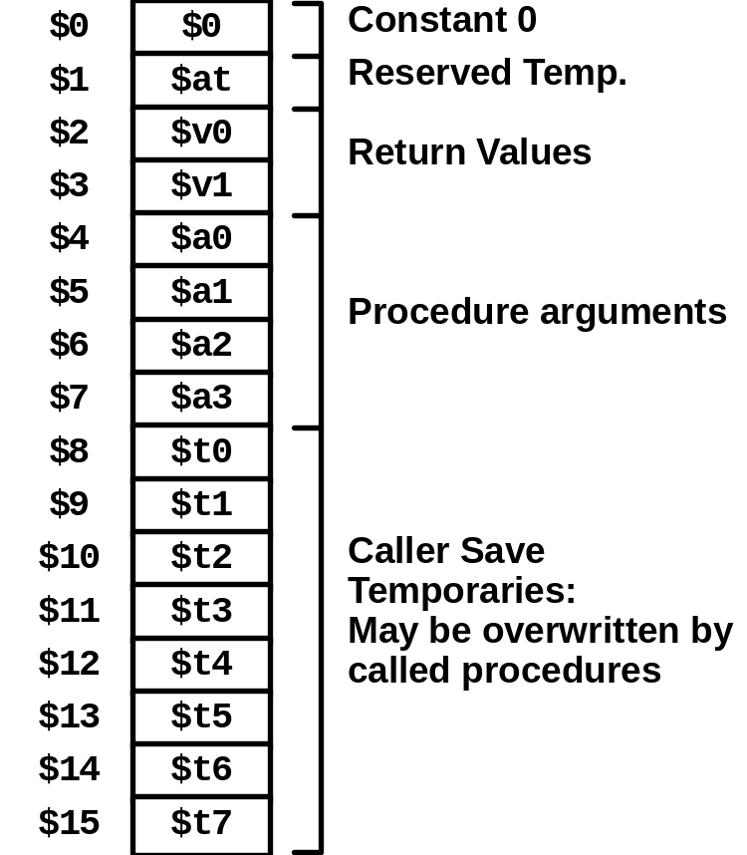
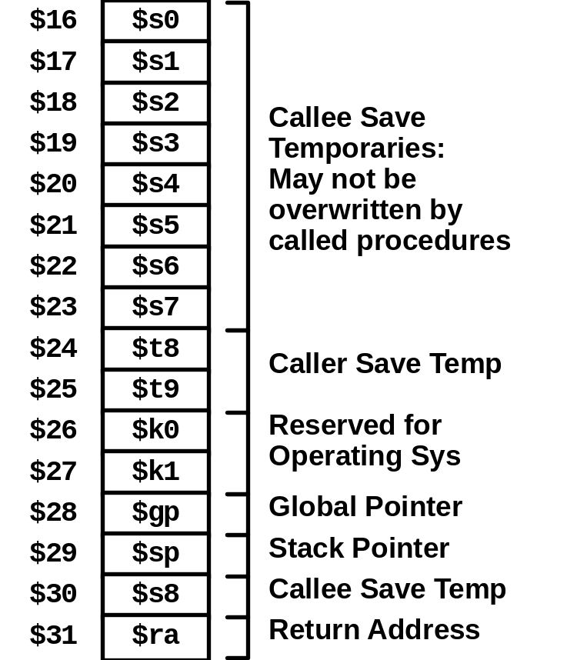
MIPS Registers

Slide 29
MIPS Instruction Examples
R-R
Op
Ra
Rb
Rd
00000
Fn
addu $3,$2,$1 # Register add: $3 = $2+$1
R-I
Op
Ra
Rb
Immediate
addu $3,$2, 3145 # Immediate add: $3 = $2+3145
sll $3,$2,2 # Shift left: $3 = $2 << 2
Branch
Op
Ra
Rb
Offset
beq $3,$2,dest # Branch when $3 = $2
Load/Store
Op
Ra
Rb
Offset
lw $3,16($2) # Load Word: $3 = M [$2+16]
sw $3,16($2) # Store Word: M [$2+16] = $3

Slide 30
CISC vs. RISC
Original Debate
  Strong opinions!
  CISC proponents---easy for compiler, fewer code bytes
  RISC proponents---better for optimizing compilers, can make run fast with simple chip design
Current Status
  For desktop processors, choice of ISA not a technical issue
    With enough hardware, can make anything run fast
    Code compatibility more important
  For embedded processors, RISC makes sense
    Smaller, cheaper, less power
    Most cell phones use ARM processor

Slide 31
Summary
Y86 Instruction Set Architecture
  Similar state and instructions as IA32
  Simpler encodings
  Somewhere between CISC and RISC
How Important is ISA Design?
  Less now than before
    With enough hardware, can make almost anything go fast
  Intel has evolved from IA32 to x86-64
    Uses 64-bit words (including addresses)
    Adopted some features found in RISC
      More registers (16)
      Less reliance on stack

Slide 32
Next
Logic design
Hardware Control Language HCL
Suggested Reading: 4.1, 4.2

